Slide 1

Social Power in NBA
NBA on court performance with social influence, popularity and power
BANA 277 Final Project
Jennifer S., Joanna Y., Manodhar A., Sushrut S., Vedant K.

Slide 2
Problem Statement
Understanding how social influence, time, and salary affect NBA players’ performance that can be used to support NBA managers’ player recruitment decision making process. We divided the analysis into 2 different parts : Player and Teams. With this, we aim to answer the following questions:
Player Level
Does social media influence, on-the-court duration, salary, and offensive vs defensive skills affect player’s on-the-court performance and contribution to team wins?
Are there differences in the salary of players who play for longer duration vs players who play for shorter duration?
Team Level
Effect on NBA fan attendance based on Team performance and Team valuation.
Can the team make decisions to improve attributes like valuation or performance based on clusters that explains the characteristics of Teams?

Slide 3
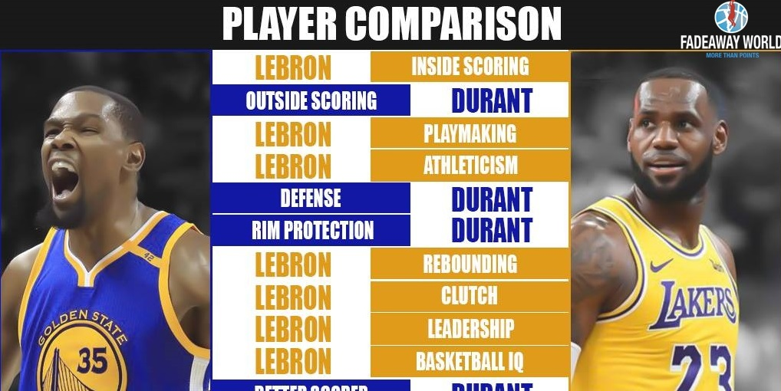
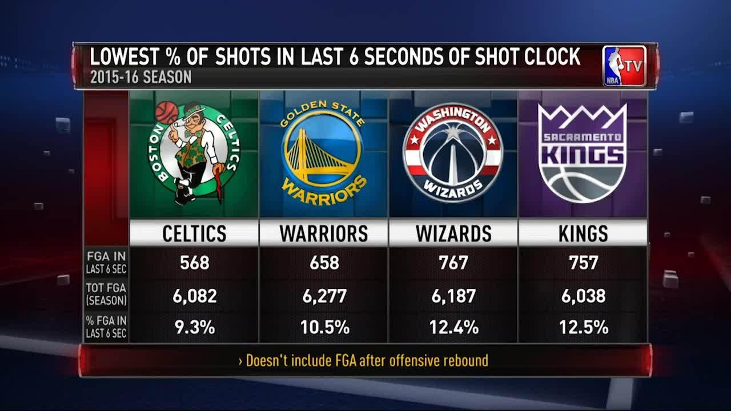
Data Sources
Data sources include ESPN, Basketball-Reference, Twitter, Five-ThirtyEight, and Wikipedia.
The competition furnished 17 excel files with approximately 13,000 data points. They described diverse data such as Team level statistics (‘Team Valuation’, ‘Team Attendance’) and Player level statistics (Offensive rating, Defensive rating, Age).

Slide 4
Explanations of Acronyms used in Analysis
Player’s Wins (wins_rpm): Provides an estimate of the number of wins each player has contributed to his team’s wins total on the season. RPM wins include the player’s Real Plus-Minus and his number of possessions played.
MP: Minutes played
TOTAL: Total attendance
AVG: Average attendance
PCT: percentage of average capacity
VALUE_MILLIONS: Team value in millions
ELO: Rating system to calculate the relative skill levels of players in competitor-versus-competitor games

Slide 5
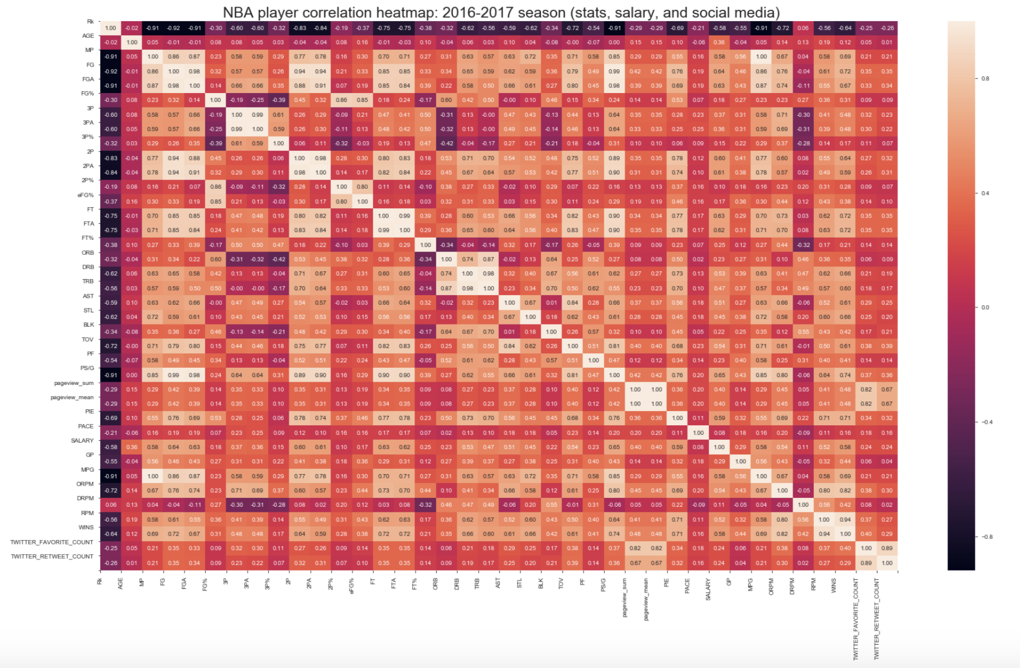
Identifying Relationships between Court Performances, Salary, and Social Media to Player Wins
Both Twitter RT and FAV counts have strong positive association with Wikipedia Pageviews.
Wins have strong positive correlation with PS/G, FG, FT, FTA, PIE, MP.
Salary has strong correlation with WINS and MP.

Slide 6
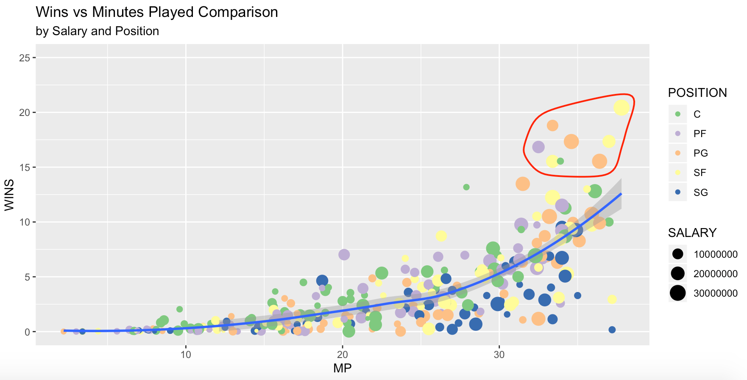
Upper Echelon of Player Wins and Minute Played is Highly Dominated with Point Guards and Small Forwards
Notes:
Findings:
There are no shooting guards in the upper echelon of player RPMs. Small forwards and point guards seem to be yielding the highest RPM per minutes played. There is only one power forward in the most elite group.
Have shooting guards and power forwards been marginalized, when it comes to contributing to a team's win? It appears so.

Slide 7
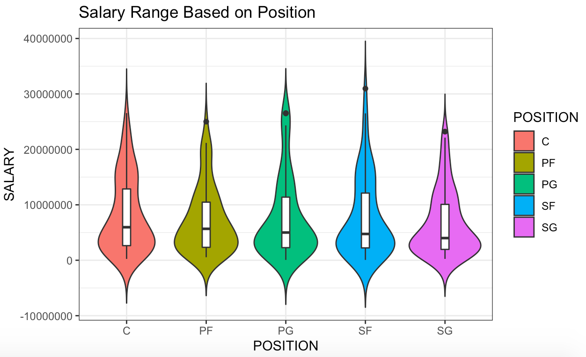
Center and Point Forward Have Higher Median Salary than The Rest
Notes:
Salary Range based on Player’s Position
Findings:
Players at the center and Point Forward are on average paid more than players at Point Guard, Small Forward, and Shooting Guard

Slide 8
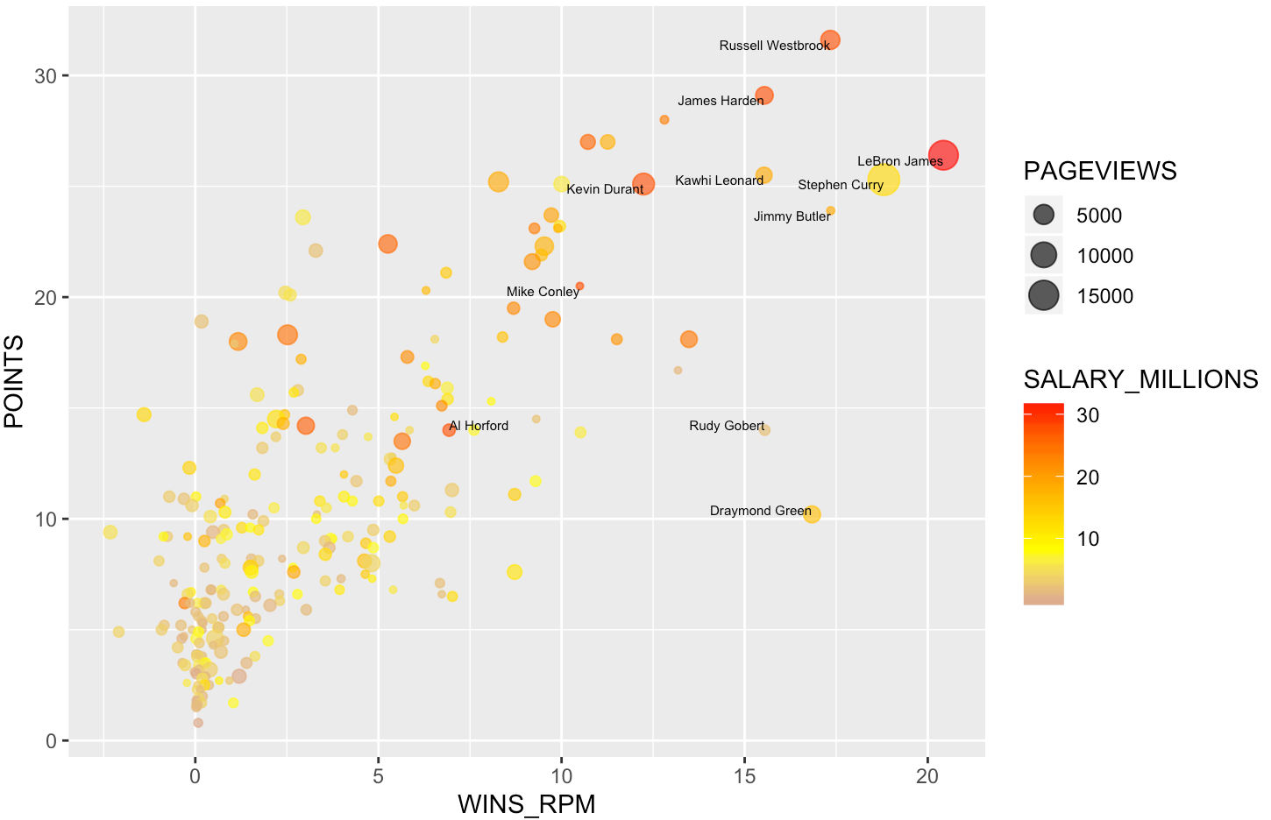
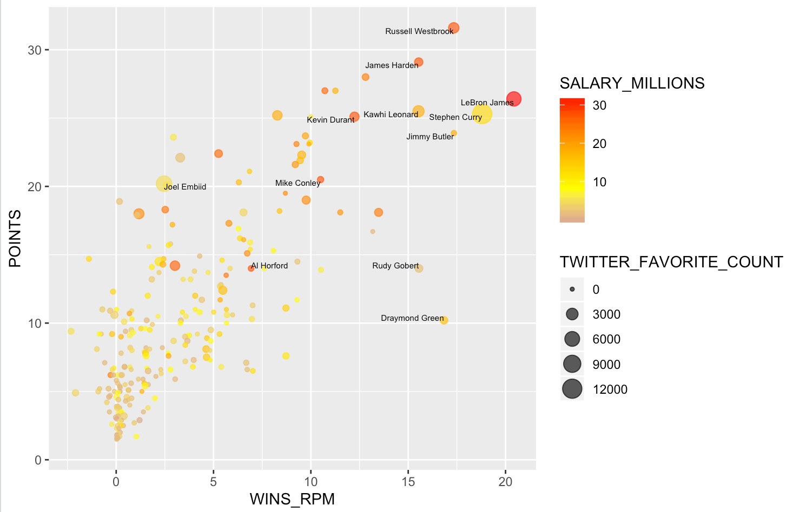
High performing players with salaries above $25Mn are popular on twitter and wikipedia pages
Note: Names displayed on the charts have salaries >$25Mn or 10k wikipedia page views or 6k twitter favourite or wins_rpm>15

Slide 9
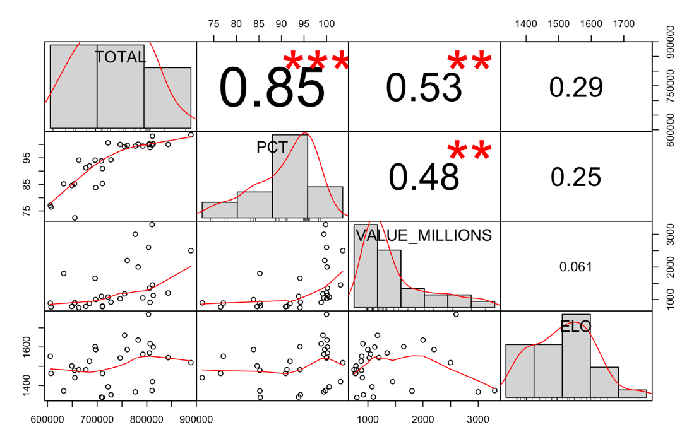
Significant correlation is observed between Total attendance and Team valuation
Significant correlation between Total attendance(TOTAL), percentage of average capacity(PCT) and value of an NBA
Only 29% of the data explains positive correlation across ELO(an indicator for relative team performance) and total attendance.
The correlation matrix shows that 53% of the data explains positive correlation between team value and total attendance.

Slide 10
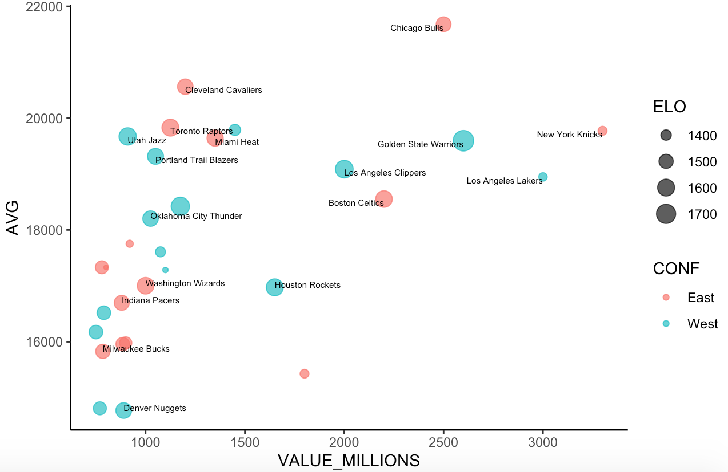
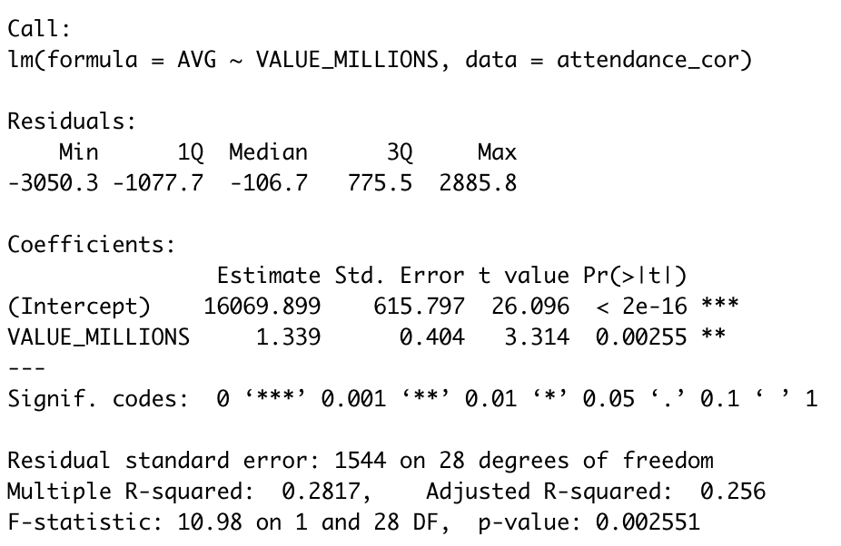
Team valuation with >1 billion has higher attendance for both eastern and western conference teams
Note: Names displayed on the charts have salaries >$2.5Bn or 20k average attendance or ELO>1500

Slide 11
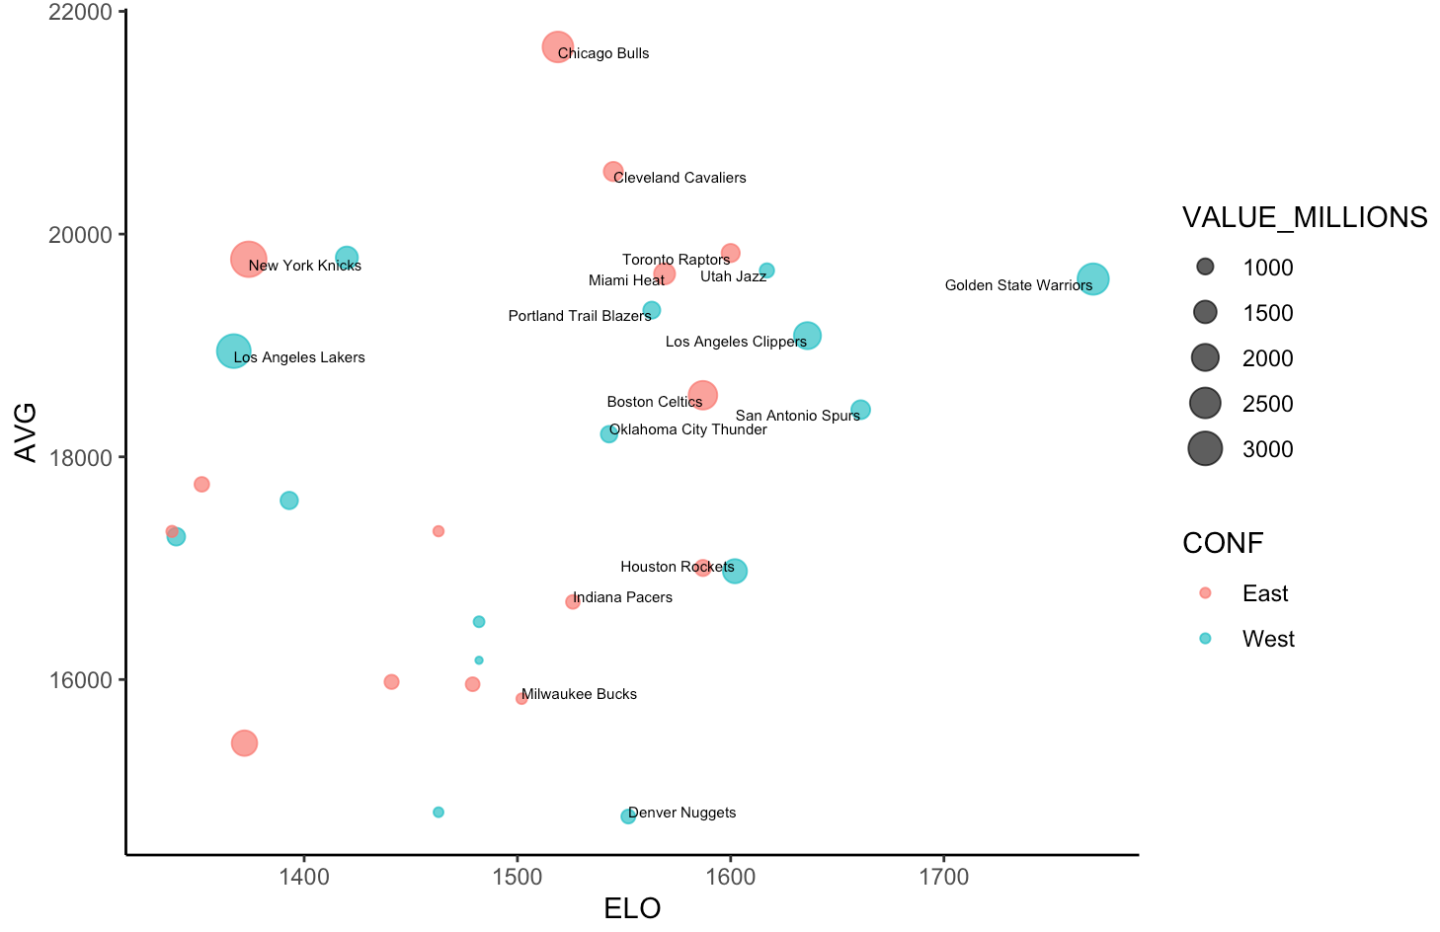
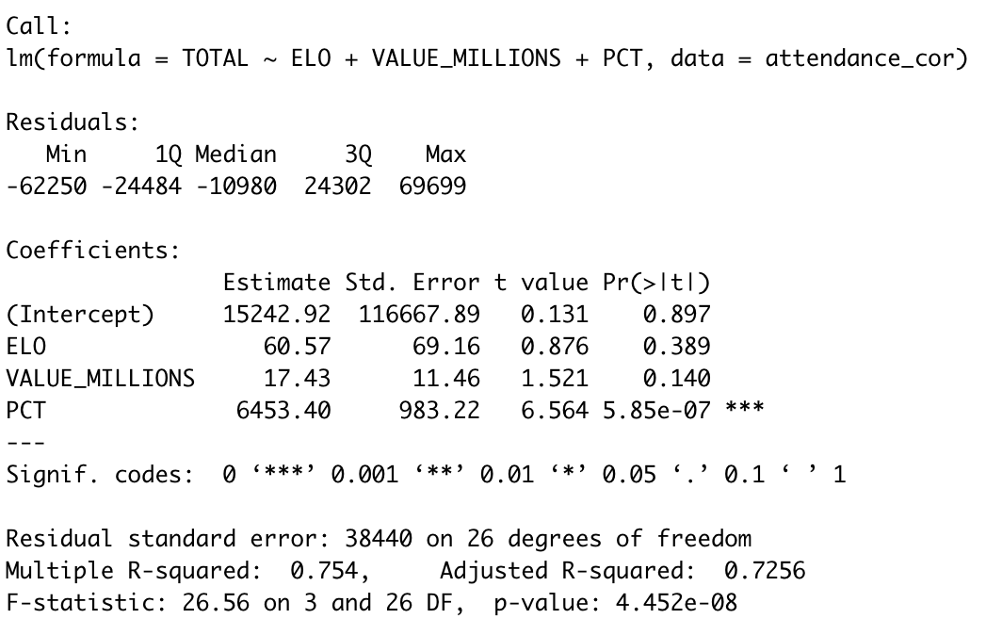
High performing teams have higher attendance for both eastern and western conference teams
Note: Names displayed on the charts have salaries >$2.5Bn or 20k average attendance or ELO>1500

Slide 12
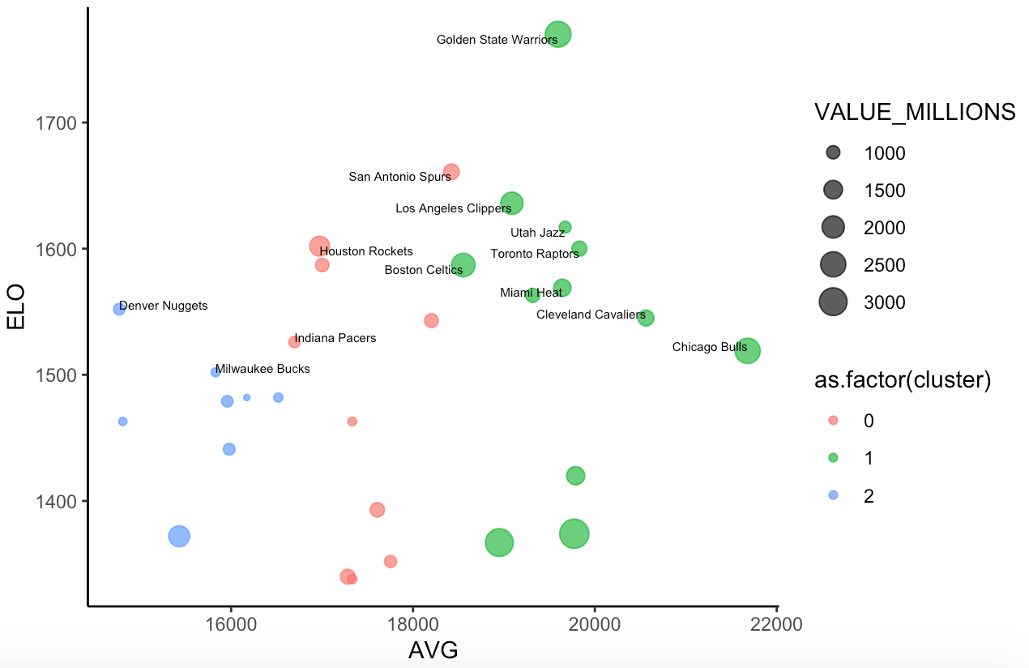
For teams with high performance and attendance, Team managers can make changes that could significantly raise the Team valuation
Note: Names displayed on the charts have 20k average attendance or ELO>1500
Teams in Cluster 1 are high performing teams with high attendance, whereas the cluster 2 are low performing teams with low attendance. Hence, there’s opportunity for the Utah Jazz to make changes in their team that could significantly raise the valuation of their team.
Notes:
Let’s consider teams Golden State warriors and Utah Jazz in cluster 1. Both of them are the best performing teams in the NBA with highest average attendance. The main difference is the team valuation for Utah Jazz is very low when compared to GSW.

Slide 13
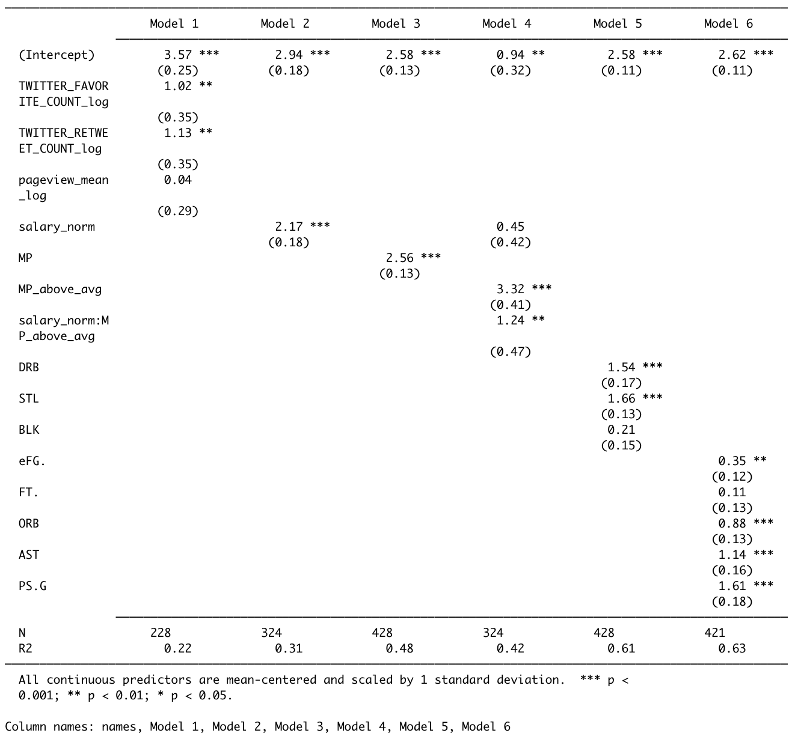
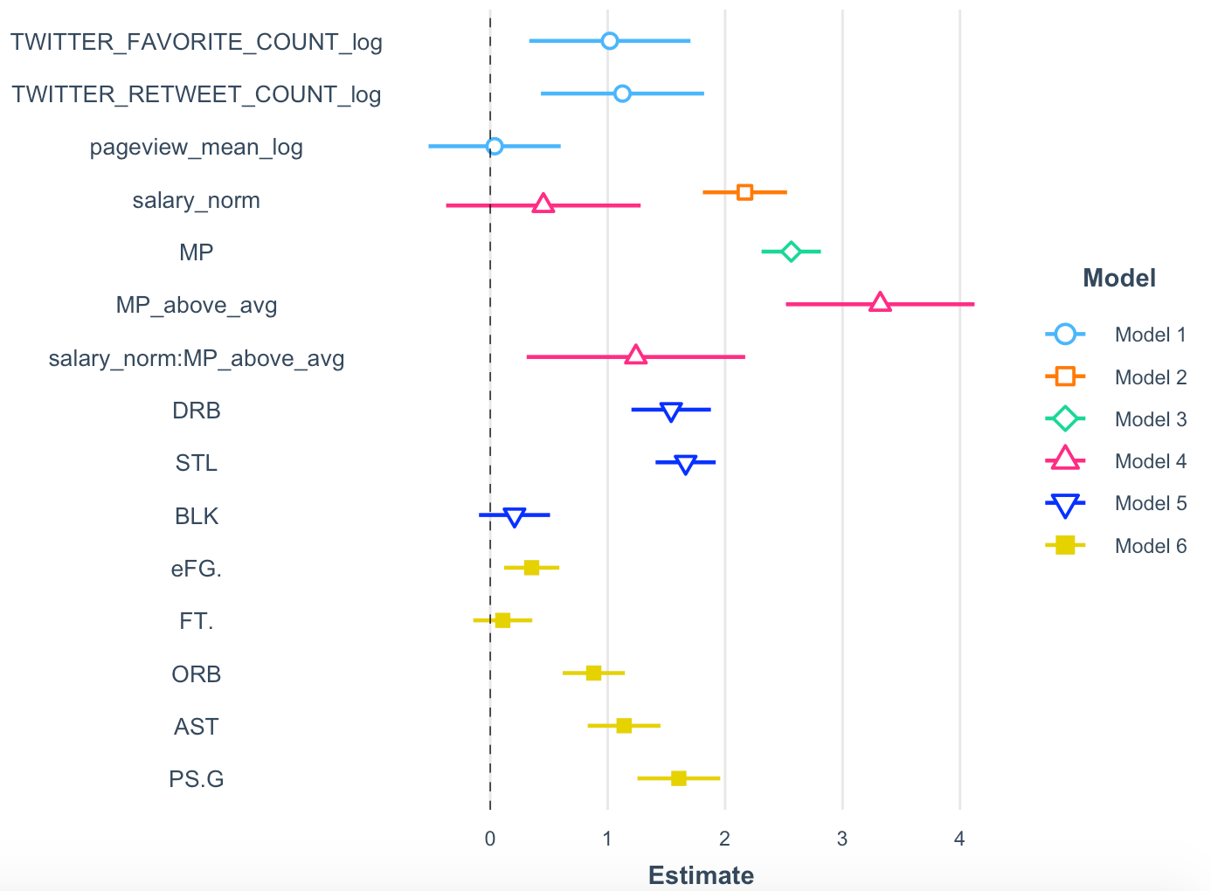
Player Level OLS Models to Identify Relationships
Notes:
Based on this we already see that offensive skills are better predictors in estimating player’s wins just by looking at the R-squared of these ols models.

Slide 14
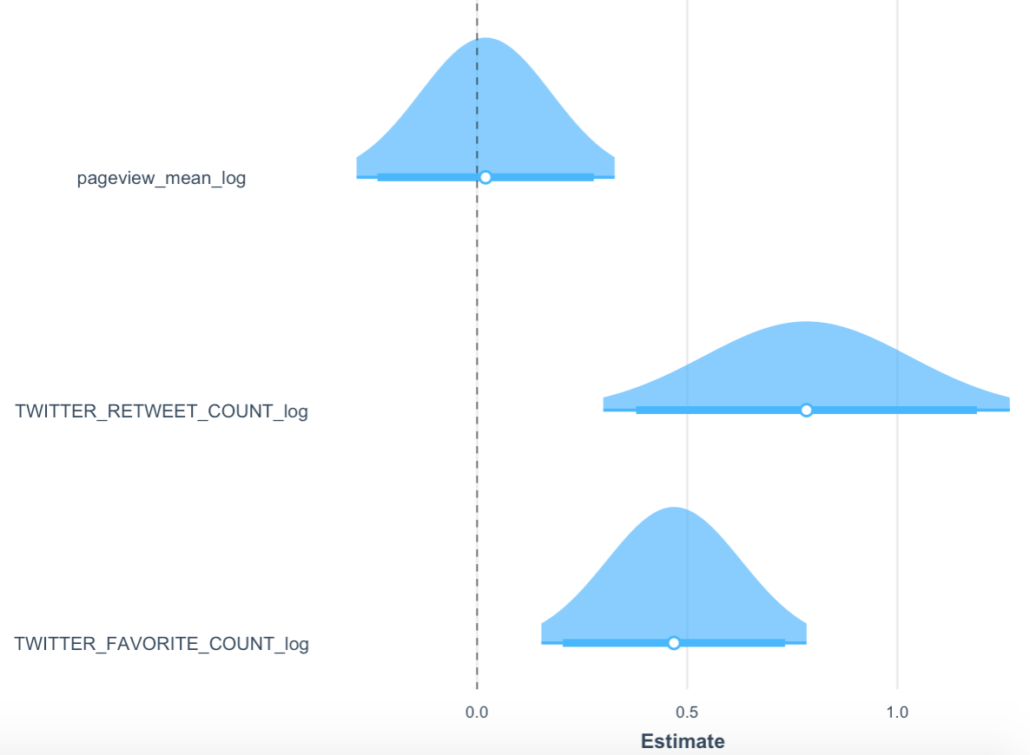
Social Media and Player Wins
(R-Squared = 0.217)
Intercept = -.4524
1% increase in twitter favorite count, on average, will increase the player wins by 0.004684 units.
1% increase in twitter retweet count, on average, will increase the player wins by 0.007839 units.
*
*

Slide 15
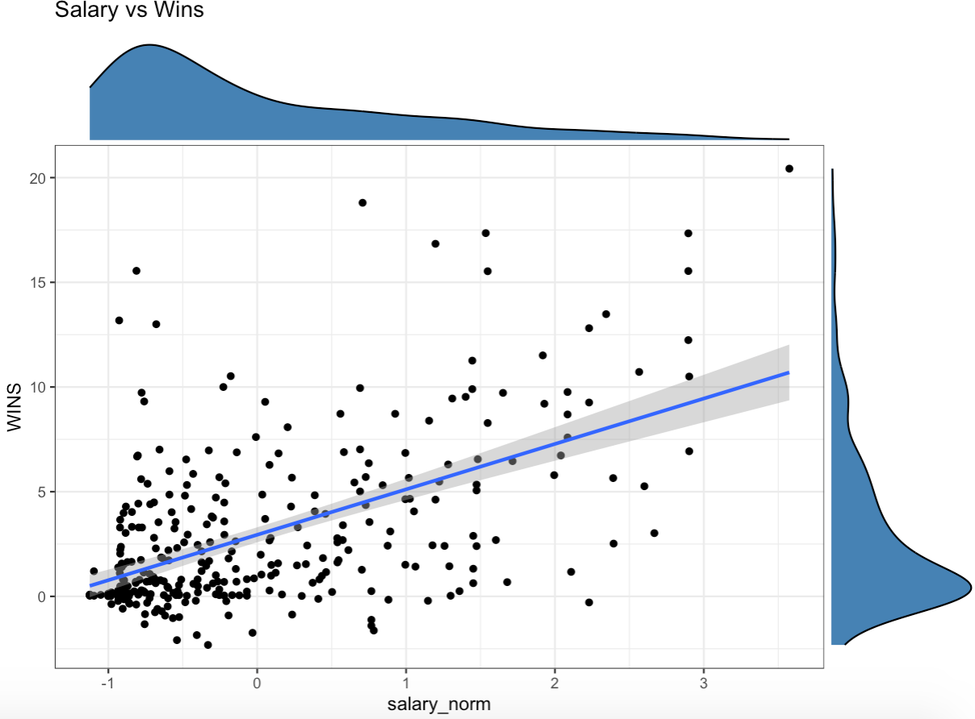
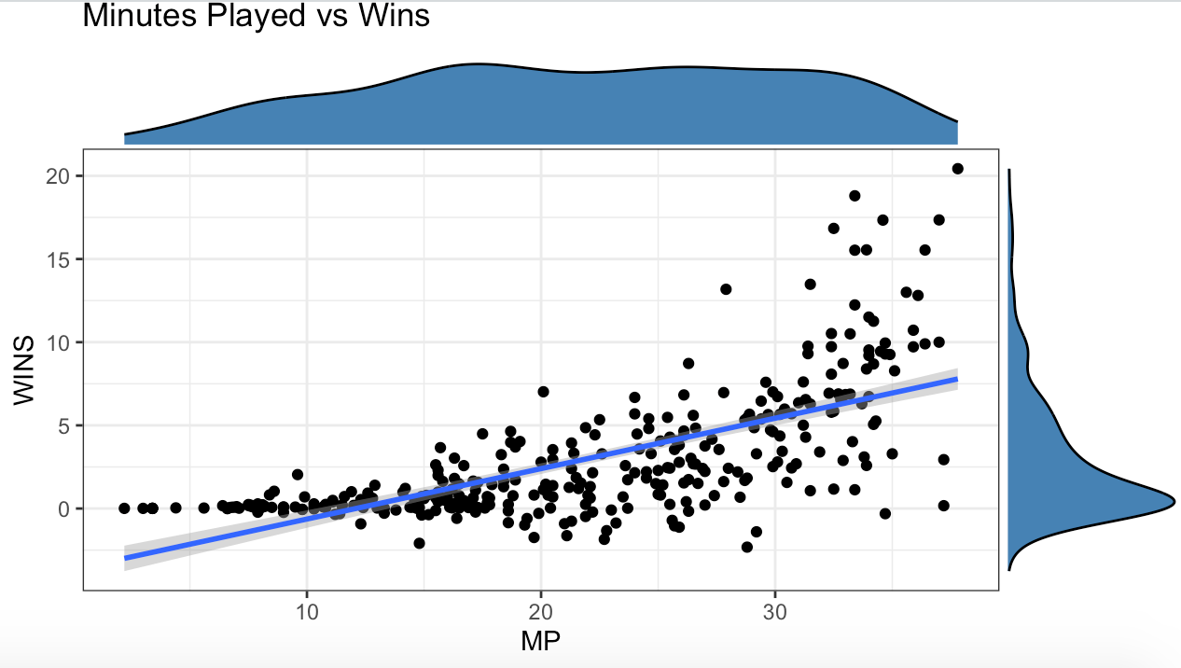
Salary and Player Wins (R-Squared = .305, p-value < 0.01)
Minutes Played and Player Wins
(R-Squared = .464, p-value < 0.01)
1 standard deviation increase in salary, on average, can increase the player’s wins by 2.169.
1 minute increase in minutes played increases the player’s wins by 0.3030.

Slide 16
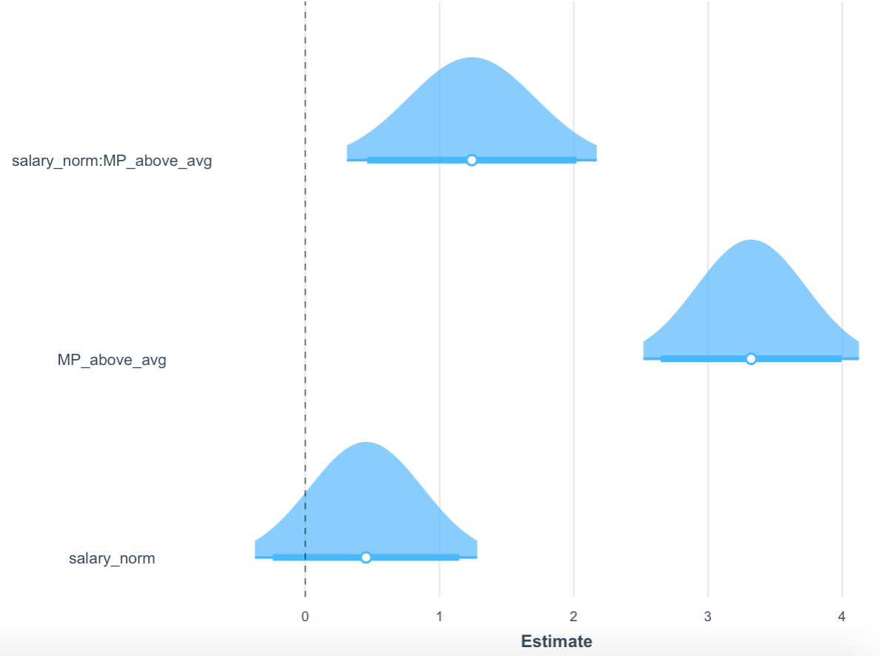
MP above vs below average and salary impact on The Player’s Wins (R-Squared .424)
Intercept = .943
Minutes Played above average clearly increases the effect of Salary in estimating the increase in player’s wins (from 0.453 to 1.241).
*
*

Slide 17
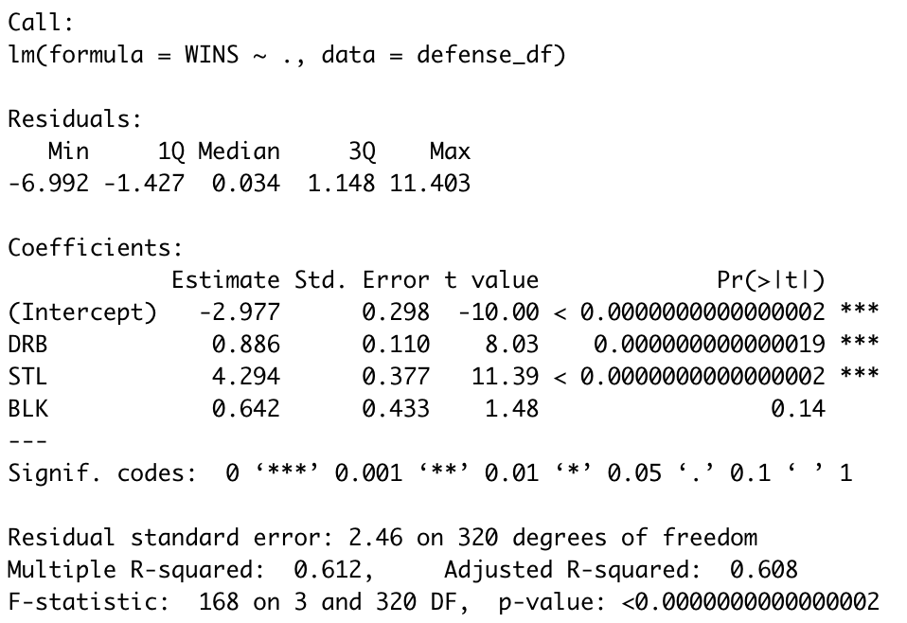
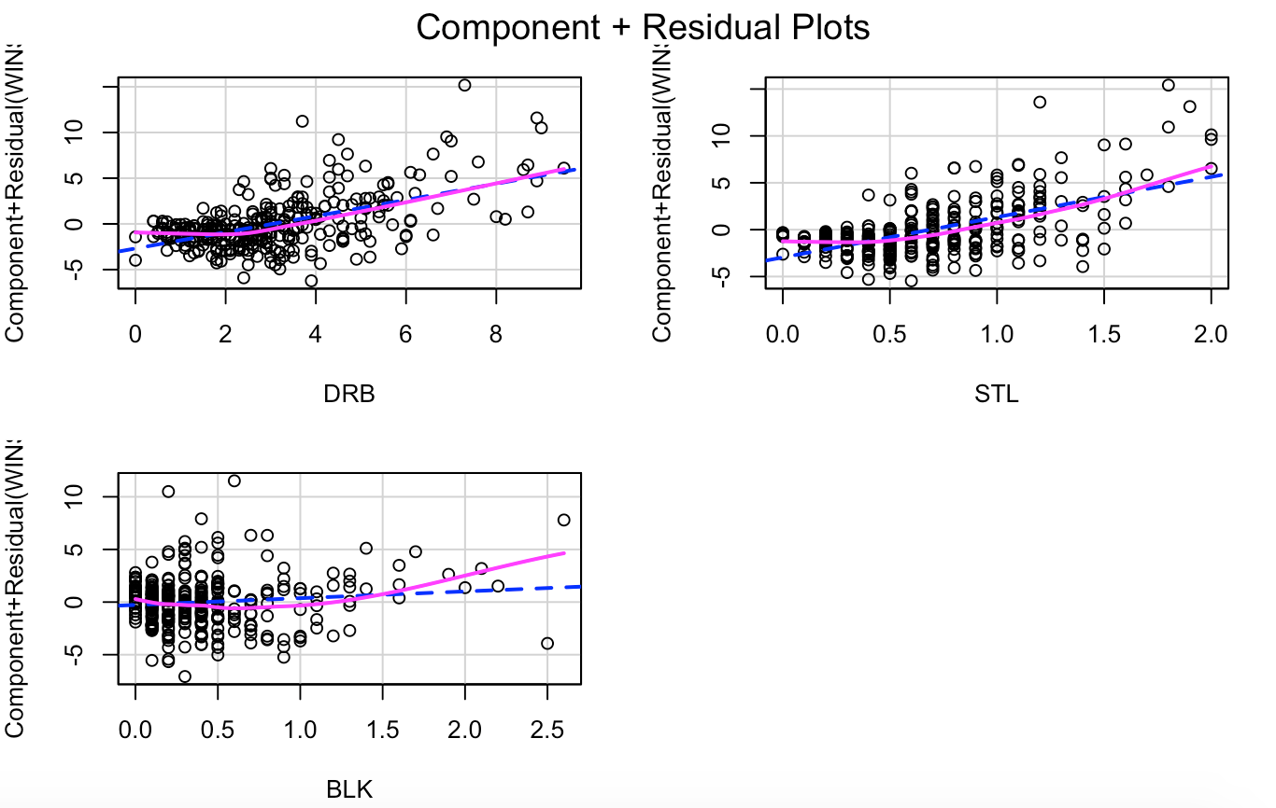
Defensive Skills Impact on Player’s Wins
Notes:
However, Steal seems to have a bigger impact in increasing the player wins estimate. As a player gets one more steal in the game, their wins will increase by 4.294 on average.
The component residual plot shows homoscedasticity in all variables with variable Steal showing the strongest homoscedasticity. This confirms the statement above.

Slide 18
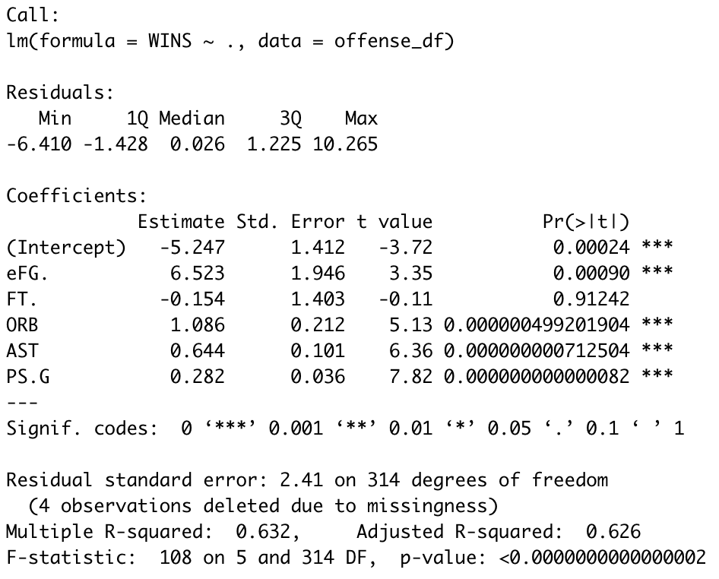
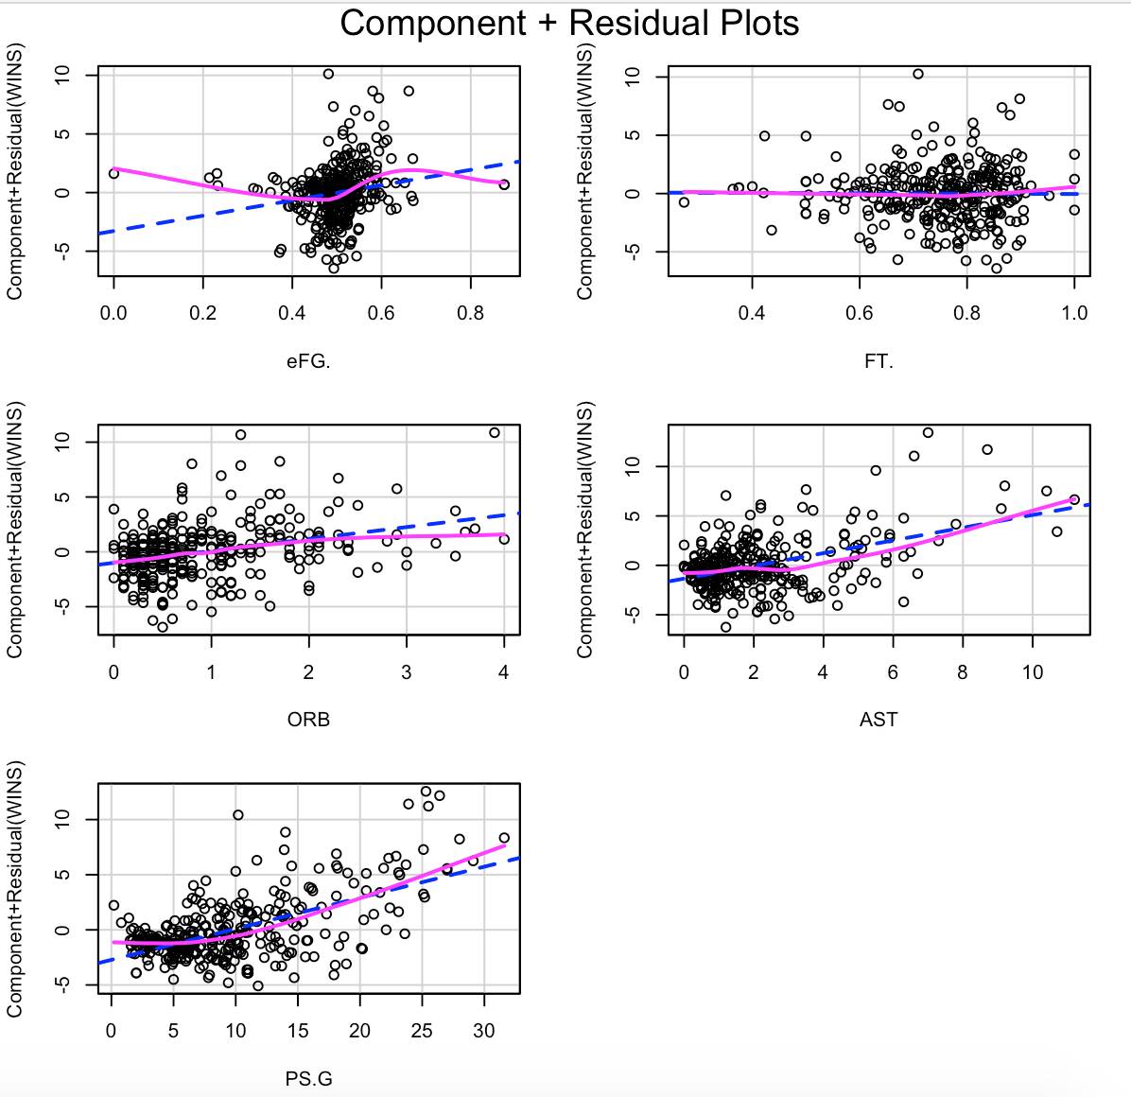
Offensive Skills Impact on Player’s Wins
Notes:
Effective Field Goal %, Offensive Rebound, Assist, and Points are all significant in estimating the player wins.
Because Effective Field Goal is in percentage,1% increase in Effective Field Goal, the player wins will increase by 0.065 on average. However, 1 unit increase in points will estimatedly increase the player’s wins by ~0.28.
Based on the residual plots, we can assume some general homoscedasticity and variable Points seems to be a stronger predictor of a player's wins.

Slide 19
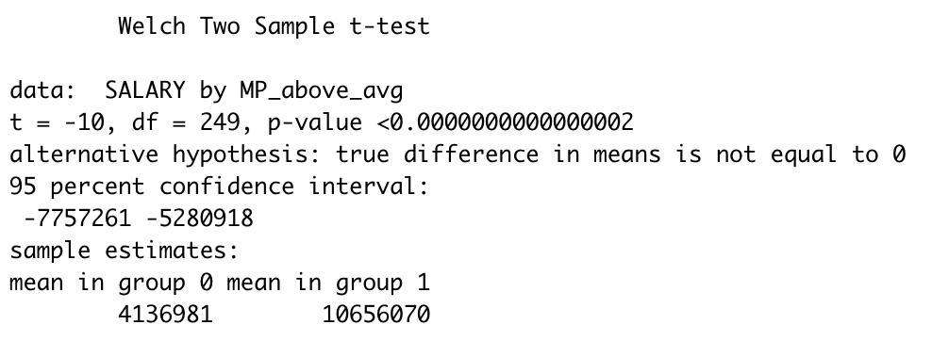
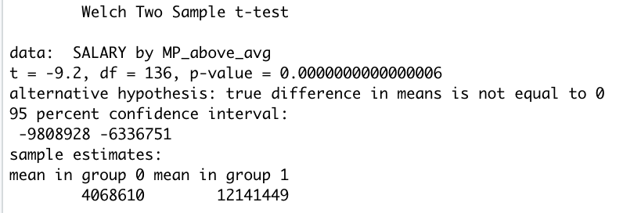
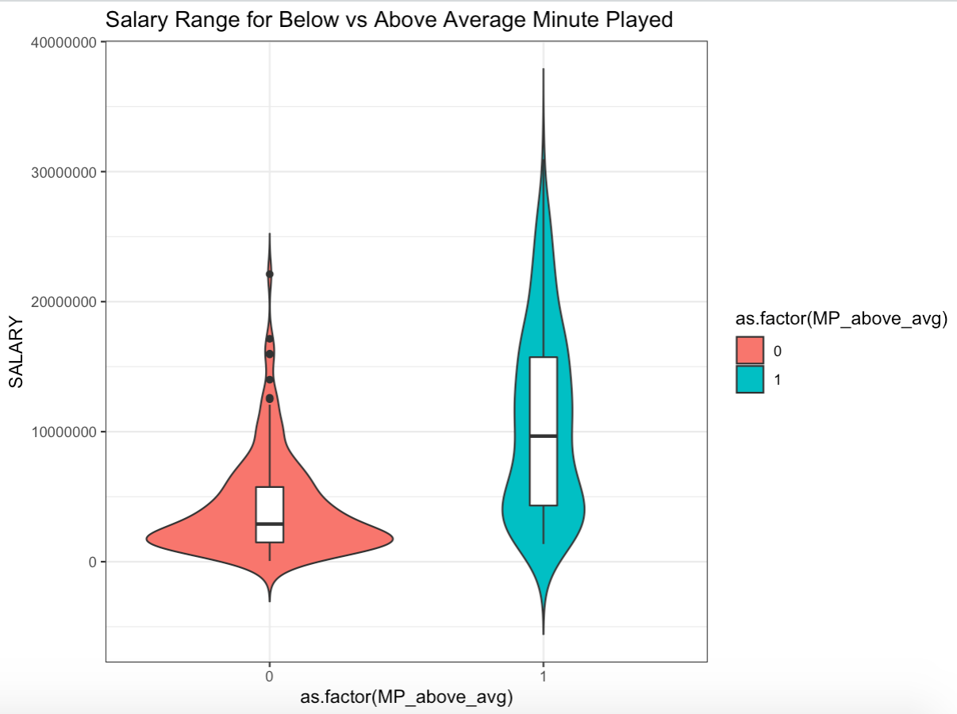
Salary Differences between Above vs Below Average MP Players
Before PSM
After PSM

Slide 20
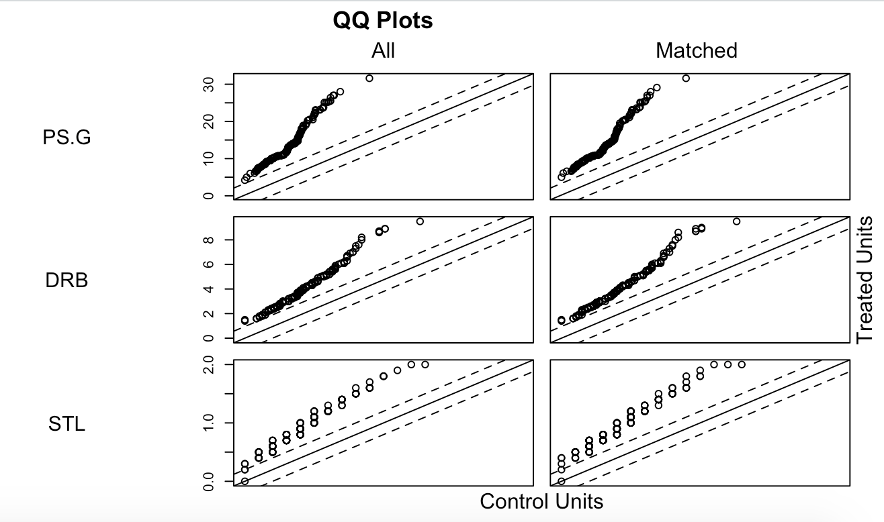
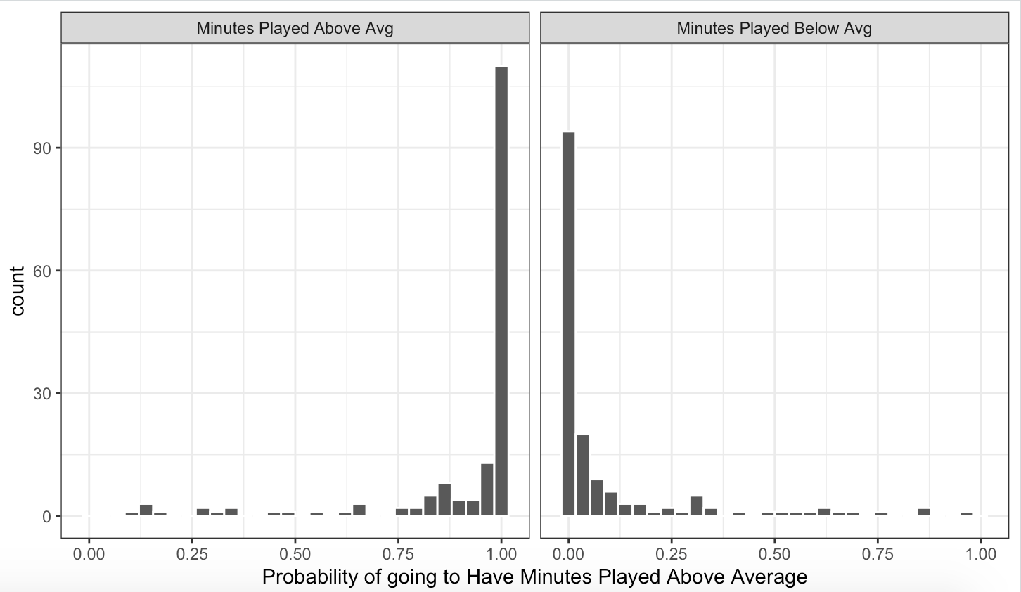
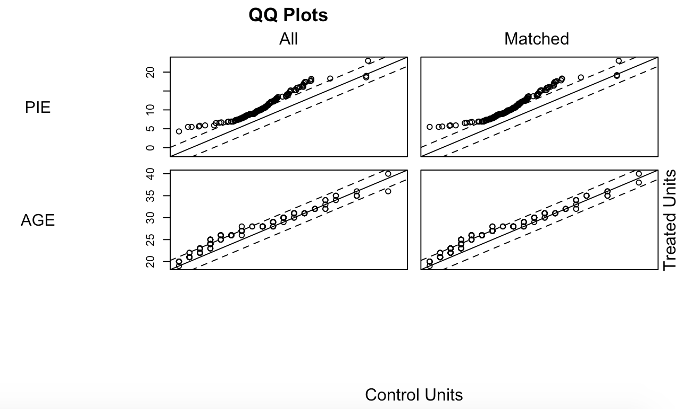
Propensity Score Matching Result
Notes:
Running PSM to test if the comparison is apples to apples. The result indicate that the salary difference is a result of non apples to apples test because in reality, the players who played above average MP have better skills and qualifications as compared to players with below MP.
Using Logistic Regressions, I predicted the probability of the players to be in the Above MP group. After running multiple models, variables such as Points, Defensive Rebounds, Steal, PIE, and Age are the significant variables to estimate the likelihood of being the above MP group.

Slide 21
Player Level Conclusion
An Ideal Player is:
A player who plays a significant amount of minutes.
A point guard or small forward. However, luckily u can pay these littles less than center.
A player who's defensive skills are emphasized via defensive rebounds and steals.
A player who's offensive skills are emphasized via an excellent effective field goal percentage, an increased frequency of assists, and a strong ability to score a lot of points
Offensive skills are better than defensive skills in predicting players wins.

Slide 22
Team Level Conclusion
Team valuation with >1 billion has higher attendance for both eastern and western conference teams
High performing teams have higher attendance for both eastern and western conference teams
For teams with high performance and attendance, Team managers can make changes that could significantly raise the Team valuation

Slide 23
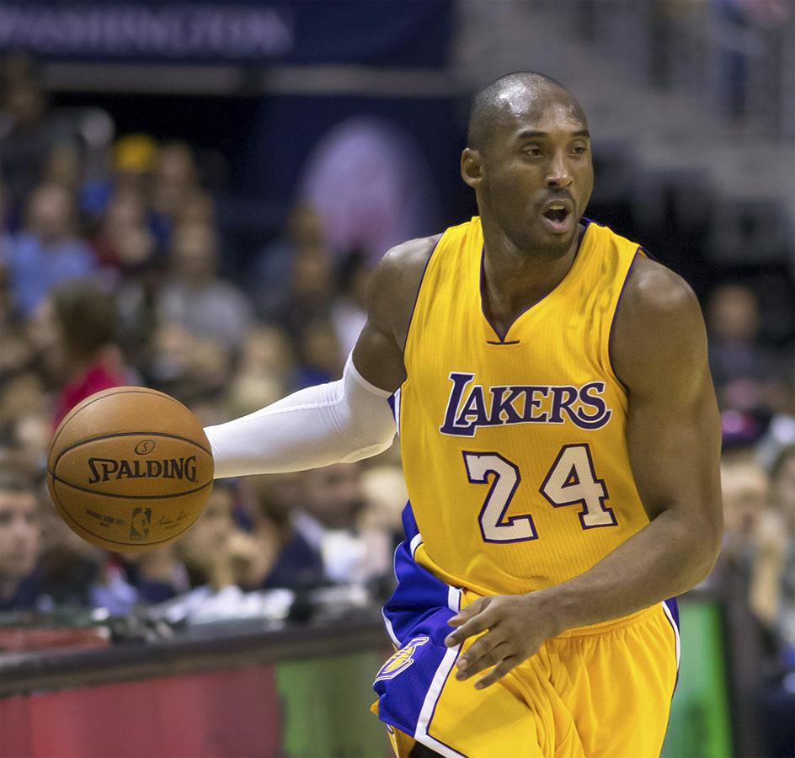
Thank you!
In Memoriam: Kobe Bryant

